Slide 1
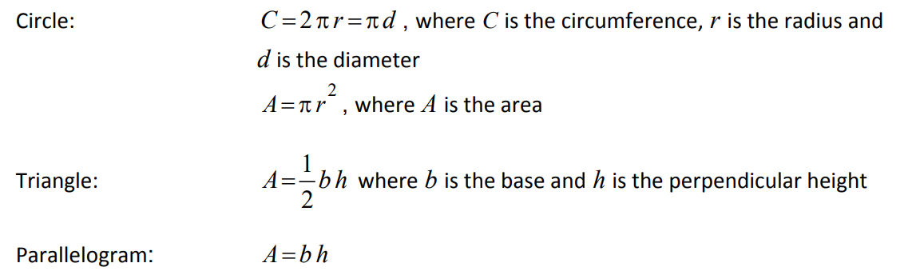
Y11 Apps Chapter 8 Assumed Knowledge
It is assumed that you can calculate the area of rectangles, parallellograms, triangles, trapeziums and circles before commencing this course. Only three of the formulas are given on your formula sheet so it is important you know rectangles and trapeziums as they are not given.

Slide 2
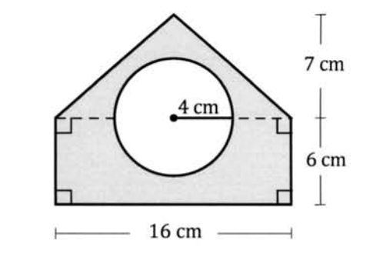
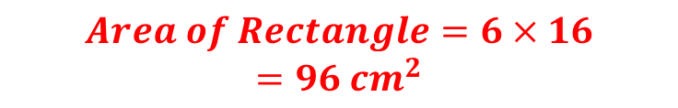
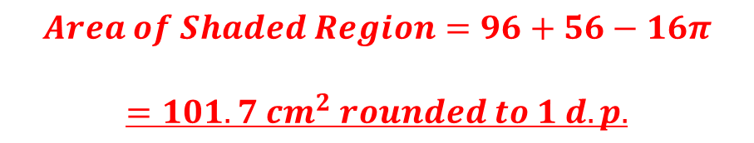

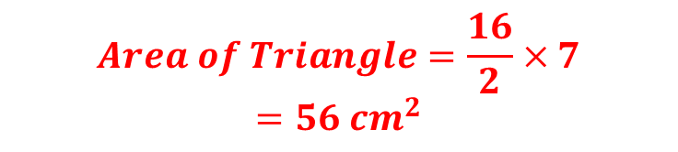
Y11 Apps Chapter 8 Example 1
Find the area of the shaded shape shown:
$$Area of Rectangle=6×16$$
$$=96 {cm}^{2}$$
$$Area of Triangle=\frac{16}{2}×7$$
$$=56 {cm}^{2}$$
$$Area of Circle=π×4^{2}$$
$$=16π {cm}^{2}$$
$$Area of Shaded Region=96+56−16π$$
$$=101.7 {cm}^{2} rounded to 1 d.p.$$

Slide 3
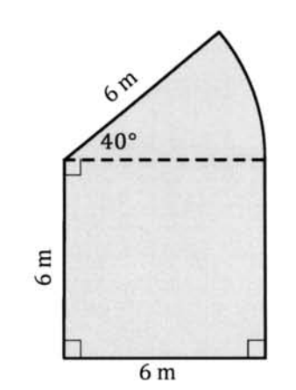
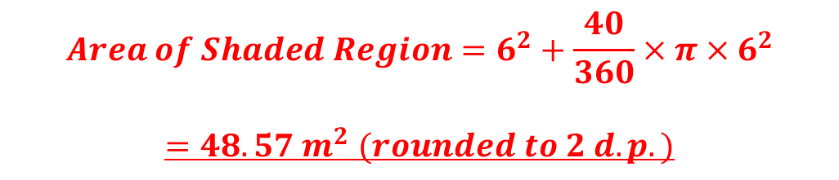
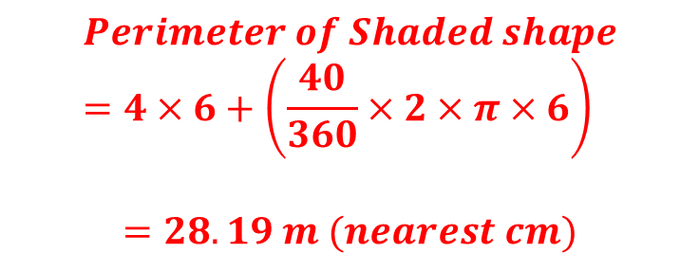

Y11 Apps Chapter 8 Example 2
Now Try Ex 8A and 8B
Find the area and perimeter of the shaded shape shown:
Sectors are $\frac{θ}{360}$ of a full circle
$$Area of Shaded Region=6^{2}+\frac{40}{360}×π×6^{2}$$
$$=48.57 m^{2} (rounded to 2 d.p.)$$
$$Perimeter of Shaded shape=4×6+\left(\frac{40}{360}×2×π×6\right)$$
$$=28.19 m (nearest cm)$$

Slide 4
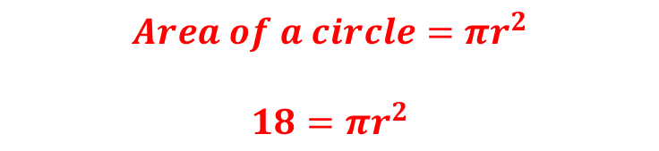


Y11 Apps Chapter 8 Example 2
Now Try Ex 8C
If a circle is to have an area of $18{cm}^{2}$ what must be the radius of the circle, to the nearest millimetre?
$$Area of a circle=πr^{2}$$
$$18=πr^{2}$$
$$\frac{18}{π}=r^{2}$$
$$\sqrt{\frac{18}{π}}=r$$
$$2.39=r$$
The radius of the circle must be 2.4cm, to the nearest millimetre

